Slide 1



Advanced PHP, Apache, and MySQL Settings
Going Beyond the Basics
Mario Peshev
Technical Trainer
www.peshev.net
Software University
http://softuni.bg

Slide 2

Table of Contents
PHP Settings
Changing Settings at Runtime
Modification through .htaccess
Apache Settings
Virtual Hosts
Modules
MySQL Settings
Database Performance

Slide 3

PHP Settings
The php.ini file

Slide 4

PHP Settings
PHP settings (called directives) are stored in the php.ini file
A set of name = value statements
If there is no value, the directive is left as name =
Comments start with a semicolon
The location of the file is different across operating systems and versions
You can check which php.ini file is loaded with phpinfo()
PHP supports add-ons
Most add-ons read their settings from the same file

Slide 5
Language Settings
Directive | Default | Description
short_open_tag | Off | Whether <? and ?> tags should be allowed
asp_tags | Off | Whether <% and %> tags should be allowed
precision | 14 | The number of significant digits displayed in floating-point numbers
expose_php | On | Include X-Powered-By: PHP/<version> HTTP header in responses
disable_functions | “” | A comma-separated list of which functions should not be available at runtime
disable_classes | “” | A comma-separated list of which classes should not be available at runtime

Slide 6
Data Handling Settings
Directive | Default | Description
track_vars | “On” | Whether or not the EGPCS ($_ENV, $_GET, $_POST, $_COOKIE, $_SERVER) arrays will be available
register_globals (Removed in PHP 5.4.0) | Off | Whether or not to register the EGPCS arrays as global variables (e. g. $_GET[“name”] will become $name)
variables_order | “EGPCS” | The order in which to register the global EGPCS arrays (“GP” means that only $_GET and $_POST will be available)
post_max_size | “8M” | The maximum size of post data allowed
default_mimetype | “text/html” | The default MIME type of the HTTP response
default_charset | “UTF-8” | The default charset of the HTTP response

Slide 7
File Upload Settings
Directive | Default | Description
file_uploads | “On” | Whether or not to allow file uploads
upload_tmp_dir | NULL | The temporary directory to store files at the server during upload
upload_max_filesize | “2M” | The maximum size of an uploaded file
max_file_uploads | 20 | The maximum number of files allowed to be uploaded at the same time

Slide 8
Paths and Directories
Directive | Default | Description
include_path | “.;path/to/php/pear” | The path where functions like include() and require() look for files
open_basedir | NULL | The only base directory (and all its subdirectories) which are accessible to PHP
doc_root | NULL | PHP’s “root directory” on the server
user_dir | NULL | The user’s home directory for PHP files
extension_dir | “path/to/php” | The path where PHP should look for dynamically loadable extensions

Slide 9
Other Settings
Directive | Default | Description
output_buffering | “4M” | How much output should be kept before pushing it to the client (“On” for unlimited buffer side, integer value for buffer size)
implicit_flush | Off | Whether or not to flush the output buffer after each block
max_execution_time | 120 | Maximum execution time of a script in seconds
memory_limit | “128M” | Maximum memory (in bytes) that a script is allowed to allocate (-1 for no memory limit)

Slide 10
Changing Settings at Runtime
Get the runtime value of a php.ini variable:
Get the value of a php.ini variable which is stored in the file:
Change the value of a php.ini variable at runtime:
See the current values of the PHP settings:
ini_get(“upload_max_filesize”);
get_cfg_var(“upload_max_filesize”);
ini_set(“include_path”, “c:/php/PEAR”);
phpinfo();

Slide 11

Apache Settings
The httpd.conf file

Slide 12
Apache Settings
Apache settings are defined in the httpd.conf file
Location and name may differ across platforms and Apache versions
Older version read from multiple files
The site-specific settings and module-specific settings are in separate files
Follows a syntax close to XML
Name-value pairs sometimes in tags

Slide 13
Prefork vs. Worker
Apache has two core modules (versions) – prefork and worker
Different behavior
Prefork is process-based, does not utilize threads much, better for single / dual core CPU servers
Worker utilizes threaded architecture – better for multi-core / CPU servers
The two modules perform differently on different tests

Slide 14
Apache Modules
Load a module:
Use conditional configuration settings:
Load mod_php:
LoadModule ssl_module modules/mod_ssl.so
<IfModule dir_module>
DirectoryIndex index.php
DirectoryIndex index.html
</IfModule>
LoadModule php5_module “C:/Program Files/PHP/php5apache2_2.dll”

Slide 15
Connection Settings
Directive | Default | Description
TimeOut | 300 | The number of seconds before the server sends timeout to a dead connection
KeepAlive | On | Turns persistent connection on or off
MaxKeepAliveRequests | 100 | The maximum number of persistent connections allowed at the same time
KeepAliveTimeout | 5 | The number of seconds before closing a dead persistent connection

Slide 16
Log Settings
Directive | Default | Description
ErrorLog | logs/error_log (Linux) / logs/error.log(Windows) | Sets the Apache log file; can be specified separately for each site
LogLevel | warn | Sets the level of logging; possible values – debug, error, info, notice, warn, error, crit, alert, emerg
LogFormat | "%h %l %u %t \"%r\" %>s %b" | Specifies nicknames for different log formats; can be used for site-specific access logs

Slide 17
Other Settings
Directive | Default | Description
Listen | 80 | Sets the port to listen for connections; can be repeated with different ports; usually specified in ports.conf file
HostnameLookups | Off | If turned on, logs the host names of remote clients instead of IP addresses
User / Group | #-1 | Sets the user and group that the Apache process should work in
DirectoryIndex | index.html | Sets the default files in a directory (shown when the user requests the directory)

Slide 18
Virtual Hosts
Apache supports multiple sites on the same IP address / port
Specified in VirtualHost directives
Usually virtual hosts are separated in different files
Requires NameVirtualHost directive
Sets the IP address and port on which Apache will receive requests for the name-based virtual hosts
IP and Port can be replaced with * (any)

Slide 19
Virtual Host Example
NameVirtualHost *:80
<VirtualHost *:80>
ServerName example.com
ServerAlias www.example.com
DocumentRoot /var/www/example/htdocs
ErrorLog /var/www/example/logs/err
CustomLog /var/www/example/logs/custom
</VirtualHost>
ServerName specifies the domain name of the virtual host
ServerAlias specifies additional names (domains) for this virtual host

Slide 20
Virtual Host Example (2)
DocumentRoot
Sets the root directory for this host
Passed to PHP in the $_SERVER[“DOCUMENT_ROOT”] variable
Be careful with the ending slash!
ErrorLog sets the host-specific error log
CustomLog sets the location and format for the host access log file

Slide 21
Location Directive
<VirtualHost *:80>
…
<Location /admin>
Require valid-user
</Location>
</VirtualHost>
The Location directive is used to define URL-specific settings
Settings are directory-based
Can be placed in VirtualHost or be server-wide

Slide 22
Directory Directive
<VirtualHost *:80>
…
<Directory /var/www/includes>
Allow from localhost
Deny from all
</Directory>
</VirtualHost>
The Directory directive is used to define file system directory settings
Can be defined server-wide or host-specific

Slide 23
Deny and Allow
The Deny from, Allow from and Order directives are used to limit access to certain hosts
Deny and Allow values are lists of hosts (space-separated), partial domain names, partial IPs or “all”
The Order directive sets whether deny or allow should be higher priority
Value is “Allow,Deny” or “Deny,Allow”
The first is with higher priority, if a host is not matched, the second in list is used

Slide 24
Deny and Allow – Examples
Allow from localhost
Deny from all
Order Allow, Deny
Allow from .net # partial domain
Deny from 192.168 # partial IP
Order Deny, Allow
Allow from localhost 192.168.0.1
Deny from 85.187.0.0/16 # deny a network
Order Deny, Allow
Allow from 2001:db8::a00:20ff:fea7:ccea
Deny from all
Order Allow, Deny

Slide 25
The Options Directive
Sets values of several additional directory-based options
Each option is prefixed with + or – to turn on or off; if no prefix is supplied, on is assumed
ExecCGI – whether CGI scripts execution is allowed in the directory
FollowSymLinks – whether Apache should use only files or can follow symbolic links in the directory

Slide 26
The Options Directive (2)
Indexes – If a URL maps to directory and there is no file that matches the DirectoryIndex directive then mod_autoindex will return page with the list of files in the directory
Turning this on for hosts / locations that do not explicitly require it is considered security risk!
<Directory /var/www/docs>
Options +Indexes +FollowSymLinks -ExecCGI
</Directory>

Slide 27
Setting up a Virtual Host – Example
To set up a virtual host:
Set your domain name to point to your external IP address
For testing you can modify the hosts file
/etc/hosts on Linux
C:\WINDOWS\System32\drivers\etc\hosts on Windows
Add NameVirtualHost and VirtualHost directives in httpd.conf
Restart Apache

Slide 28
Using HTTPS
HTTPS is HTTP over SSL / TLS
Apache has separate module for handling https
Running virtual host over https requires a certificate and connection on port 443
In Linux the packages openssl and ssl-cert are necessary too
Apache has automated script for generating certificates – apache2-ssl-certificate

Slide 29
Configuring HTTPS
Example of virtual host with SSL:
The SSLEngine directive turns on the SSL security engine
SSLCertificateFile supplies a valid certificate file
The domain property in the file must match the host name
<VirtualHost *:443>
ServerName phpmyadmin.example.com
DocumentRoot /usr/shared/phpmyadmin/
SSLEngine on
SSLCertificateFile /etc/apache2/ssl/myadmin.pem
</VirtualHost>

Slide 30
Configuring HTTPS – Example
First ensure that httpd-ssl.conf file will be loaded. Put this code in httpd.conf:
Create a self-signed SSL certificate:
Define a virtual host on port 443 with SSL engine switched on
Restart Apache
Include conf/extra/httpd-ssl.conf
openssl genrsa 1024 > host.key
openssl req -new -x509 -nodes -sha1 -days 365 -key host.key > host.cert
cat host.cert host.key > host.pem

Slide 31
HTTP Authentication
The Apache module mod_auth allows the use of basic HTTP authentication
Restrict or allow access to certain areas
Requires user and password input
For stronger authentication and scalability use mod_auth_digest or mod_auth_dbm
Usernames and password are stored encrypted in a file

Slide 32
mod_auth Directives
Directive | Description
AuthType | Sets the type of user authentication; possible values – Basic and Digest
AuthName | User-friendly name of the realm that requires authorization; must be enclosed in quotation marks
AuthUserFile | Specifies the file which stores users and passwords
AuthGroupFile | Specifies the file which stores the user groups (lists of users); groups cannot be nested or inherited
Example content of a groups file:
Never put the users or groups files in the document tree of the site!
Boss: john pesho
Accounting: mara ceca
Testers: chocho bobo shusi

Slide 33
Require Directive
Require sets which users/groups are allowed to access the realm
The possible values are: Require user [list of users] Require group [list of groups] Require valid-user

Slide 34
The htpasswd Tool
Apache comes with a small tool for generating user files named htpasswd
Encrypts the passwords
Usually these files are named .htpasswd
// The –c flag means “create a new file”
htpasswd –c .htpasswd mara
// Asks you to supply password
// Add new user
htpasswd .htpasswd john
// Again asks for password

Slide 35
Authentication – Example
<VirtualHost *:80>
ServerName example.com
DocumentRoot /var/www/ex/htdocs
…
<Location /admin>
AuthType Basic
AuthName "Example admin area"
AuthUserFile /var/www/ex/.htpasswd
</Location>
</VirtualHost>

Slide 36
Using .htaccess
Apache can read additional settings from files in the site document tree
The name of the file is controlled by the AccessFileName server directive
Usually named .htaccess
In the .htaccess file can be placed all directives, valid for Location
Slows down the server
It has to read it again on every request

Slide 37
Example .htaccess
Options +Indexes
AuthType Basic
AuthName "test"
AuthUserFile ".htpasswd"
php_value register_globals off
Apache reads all .htaccess files in the directories from the document root up to the requested resource and combines them
Can contain mod_rewrite settings
Can contain PHP settings with the php_value directive

Slide 38
mod_rewrite
mod_rewrite allows rule-based rewriting and redirecting of requests
Example: user requests index.html but the rewrite rules change this to index.php
This is NOT redirecting!
Used to make friendly URLs, rename resources, etc.
Based on regular expressions
Operates on per-server or per-directory context

Slide 39
Rewriting Directives
Directive | Description
RewriteEngine | Enables or disables the runtime URL rewriting engine
RewriteBase | Sets the base URL for per-directory (.htaccess) rewriting
RewriteRule [pattern][substitution][flags] | If the requested URL matches the pattern it is rewritten with the replacement; allows using back-references and groups

Slide 40
RewriteRule Flags
[L] – rewriting should stop and no other rules should be checked
[F] – force 403 Forbidden response code
[G] – force 410 Gone response code
[R=(code)] – force redirect with response code
User is redirected to the result URL
[N] – restart rewriting with the new address
[NC] – case-insensitive match
[C] – chain the current rule with the next
If not matched, skips the chained rules

Slide 41
URL Rewriting – Example
RewriteEngine On
# Rewrite directories to index files
RewriteRule ^(.*)/$ $1/index.html
# Send all html files to the template engine
# so the URLs are friendly
RewriteRule ^(.*).html$ /template.php?page=$1
# Generate the human validation image
RewriteRule ^captcha.gif$ /captcha_gen.php
# Stream the videos
RewriteRule ^/(.{10}).swf$ /stream.php?vid=$1
# Rewrite product URLs
RewriteRule ^/products/(.*)/(.*).html$ /product.php?category=$1&product=$2

Slide 42
RewriteCond
The RewriteCond directive defines a rule condition
Used to match HTTP headers, connection and request properties, server settings, system properties, etc.
One or more RewriteCond directives can precede RewriteRule directive
All conditions must match to rewrite the URL

Slide 43
RewriteCond – Example
# Mozilla users special page
RewriteCond ${HTTP_USER_AGENT} ^Mozilla.*
RewriteRule ^/index.html$ /index.mozilla.php
# Internal network special home page
# Use for the 10.0 and 192.168 networks
RewriteCond %{REMOTE_HOST} ^10.0.*$ [OR]
RewriteCond %{REMOTE_HOST} ^192.168.*$
RewriteRule ^/index.html$ /index.internal.php
# Only HTTP authenticated user admin
RewriteCond %{REQUEST_METHOD} ^HEAD$
RewriteCond %{REMOTE_USER} ^admin$
RewriteRule .* $1 [F] # Force forbidden!

Slide 44

MySQL Settings
The my.cnf and my.ini files

Slide 45
MySQL Settings
MySQL settings are in the following files:
my.cnf
my.ini
Split into sections
Section name is defined in [ and ]
Settings are in name = value form

Slide 46
Network Settings
Setting | Description
port | Sets the connection port (usually 3306); passed to all clients
bind-address | Sets interfaces to listen on; for security reasons this is usually 127.0.0.1 (allows only local connections)

Slide 47
Fine tuning settings
Fine tuning of MySQL is done in the mysqld section
Defines memory usages for buffers and connections
Setting | Description
key_buffer | Size of the cache buffer for primary and foreign keys
join_buffer | Size of the cache buffer for matching fields from two tables; increase if multiple joins in one query are used often
sort_buffer_size | Size of the buffer for sorting; increase when sorting too many rows
thread_cache_size | Size of the cache for each thread; increase when running nultiple queries on the same tables in a single script

Slide 48
Fine tuning settings (2)
Setting | Description
table_cache | Size of the per-table cache
thread-concurrency | Concurrency level of threads; supposed to affect only Solaris platforms (but works well on Linux); set to double the number of CPU cores
wait_timeout | The number of seconds to wait before closing a dead connection
wait_interactive_timeout | The time the server waits for a persistent connection

Slide 49
MySQL Tuning – Example
Always play around with the settings, testing with benchmarks
Apache Benchmark (AB)
key_buffer = 250M
max_allowed_packet = 16M
thread_stack = 128K
thread_cache_size = 128
max_connections = 1000
table_cache = 6000
thread_concurrency = 16
wait_timeout = 100
interactive_timeout = 100
connect_timeout = 10

Slide 50
MySQL Tuning – Example (2)
join_buffer = 2M
sort_buffer_size = 2M
read_buffer_size = 2M
read_rnd_buffer_size = 768K
myisam_sort_buffer_size = 64M
query_cache_limit = 4M
query_cache_size = 128M
query_cache_type = 1

Slide 51
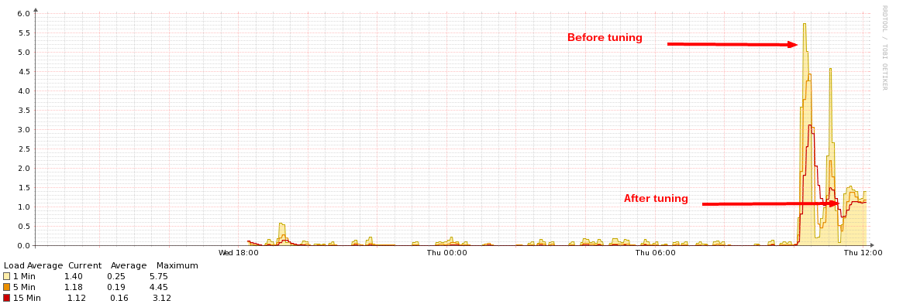
Result from changing my.cnf / my.ini files

Slide 52
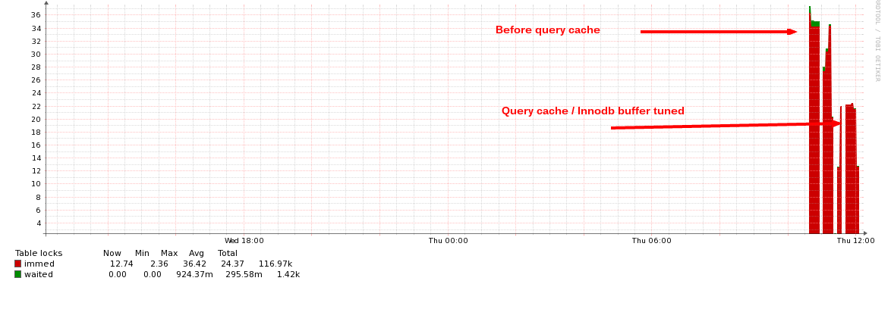
Result from changing my.cnf / my.ini files

Slide 53

Summary
PHP Settings
php.ini file
Apache Settings
httpd.conf file
Virtual hosts
Modules
MySQL Settings
my.cnf / my.ini files
Fine tuning and performance

Slide 54
Advanced PHP, Apache, and MySQL Settings
http://softuni.org/courses

Slide 55
License
This course (slides, examples, demos, videos, homework, etc.) is licensed under the "Creative Commons Attribution-NonCommercial-ShareAlike 4.0 International" license
Attribution: this work may contain portions from
"Fundamentals of Computer Programming with C#" book by Svetlin Nakov & Co. under CC-BY-SA license
"C# Part I" course by Telerik Academy under CC-BY-NC-SA license

Slide 56





Free Trainings @ Software University
Software University Foundation – softuni.org
Software University – High-Quality Education, Profession and Job for Software Developers
softuni.bg
Software University @ Facebook
facebook.com/SoftwareUniversity
Software University @ YouTube
youtube.com/SoftwareUniversity
Software University Forums – forum.softuni.bg

